Slide 1


Stanford Research Computing
Stats 285 Fall 2019
Cluster computing Introduction and the Sherlock
High Performance Computing Cluster

Slide 2
Overview
Intro to SRCC
Overview of HPC
Parallel computing
HPC/On Prem versus cloud
HPC example system: Sherlock cluster
SLURM and submitting jobs

Slide 4
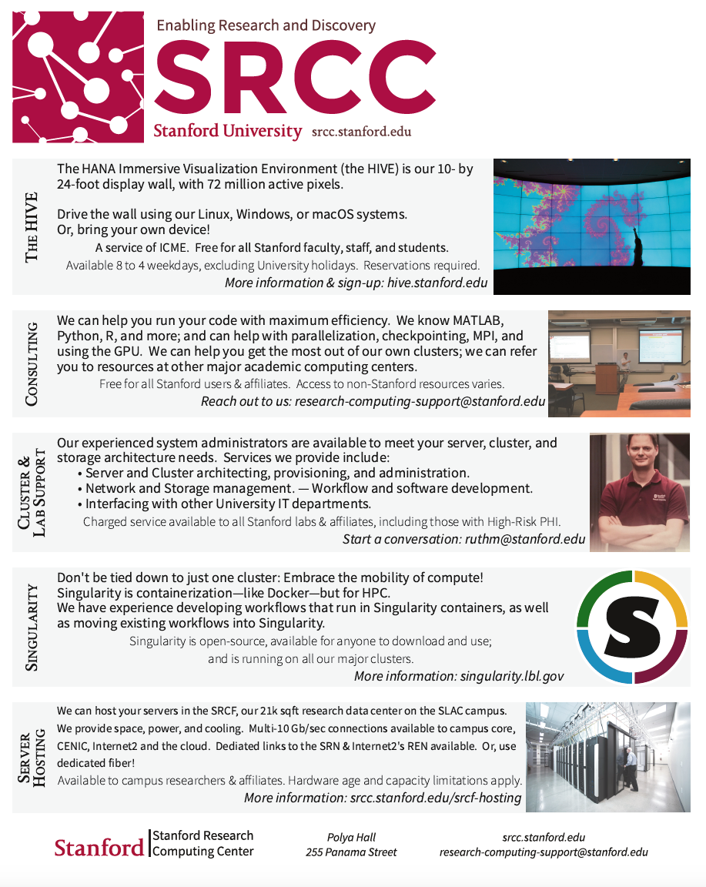

Slide 5
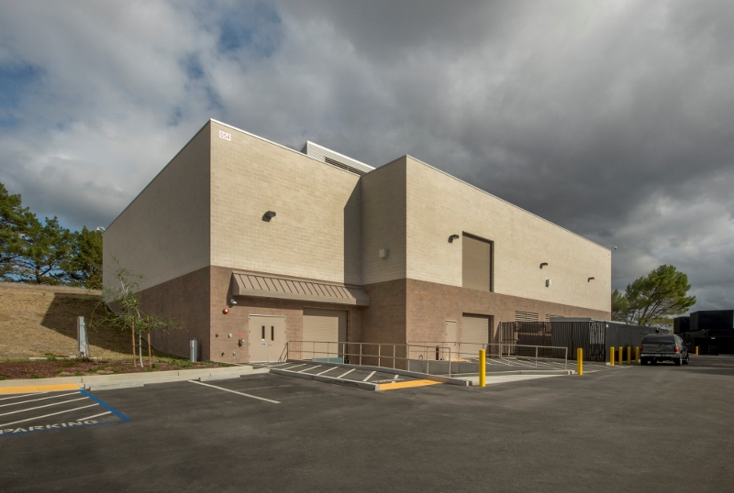
SRCF: Our Data Center
21,000 sq. ft. high density secure computing facility.
10 and 100GB networked
~4,000 servers
Located on the SLAC campus, leading edge energy conservation features
415V power direct to the server cabinets
100% outside air with all outside air relieved from the space via natural convection (zero fan energy for outside air exhaust).

Slide 6
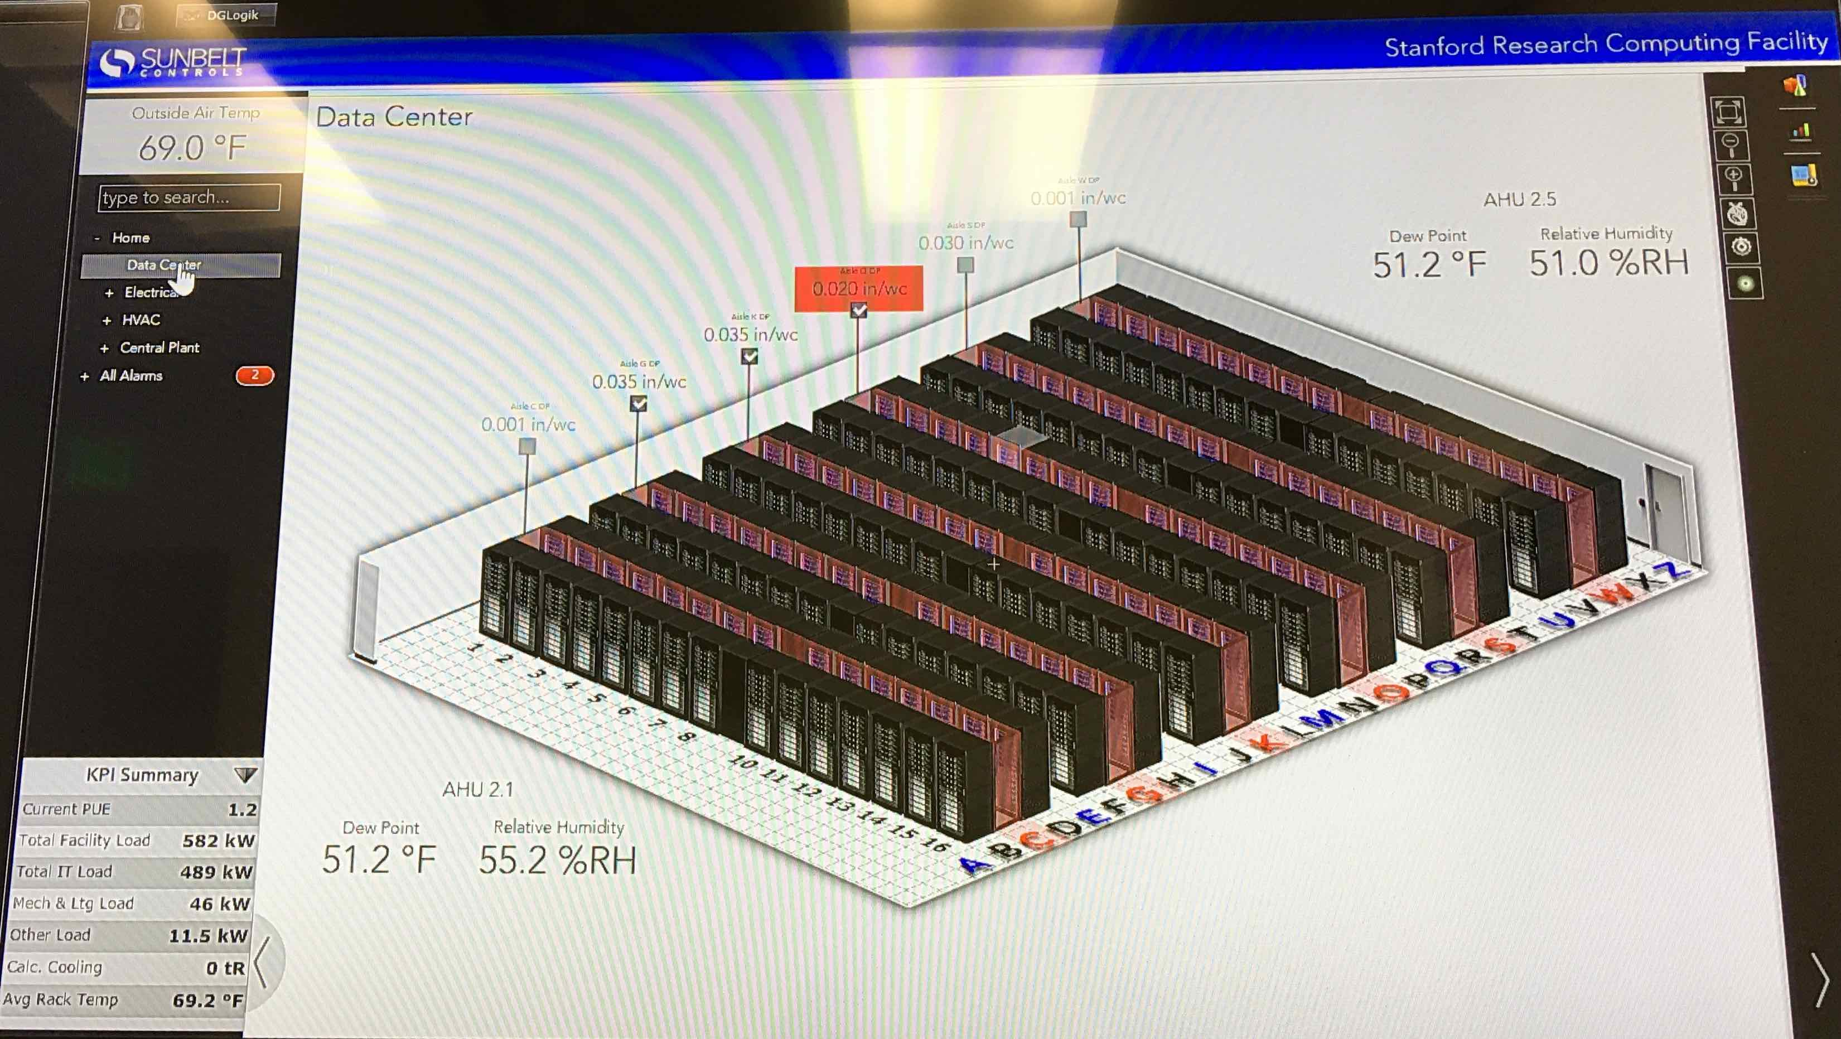
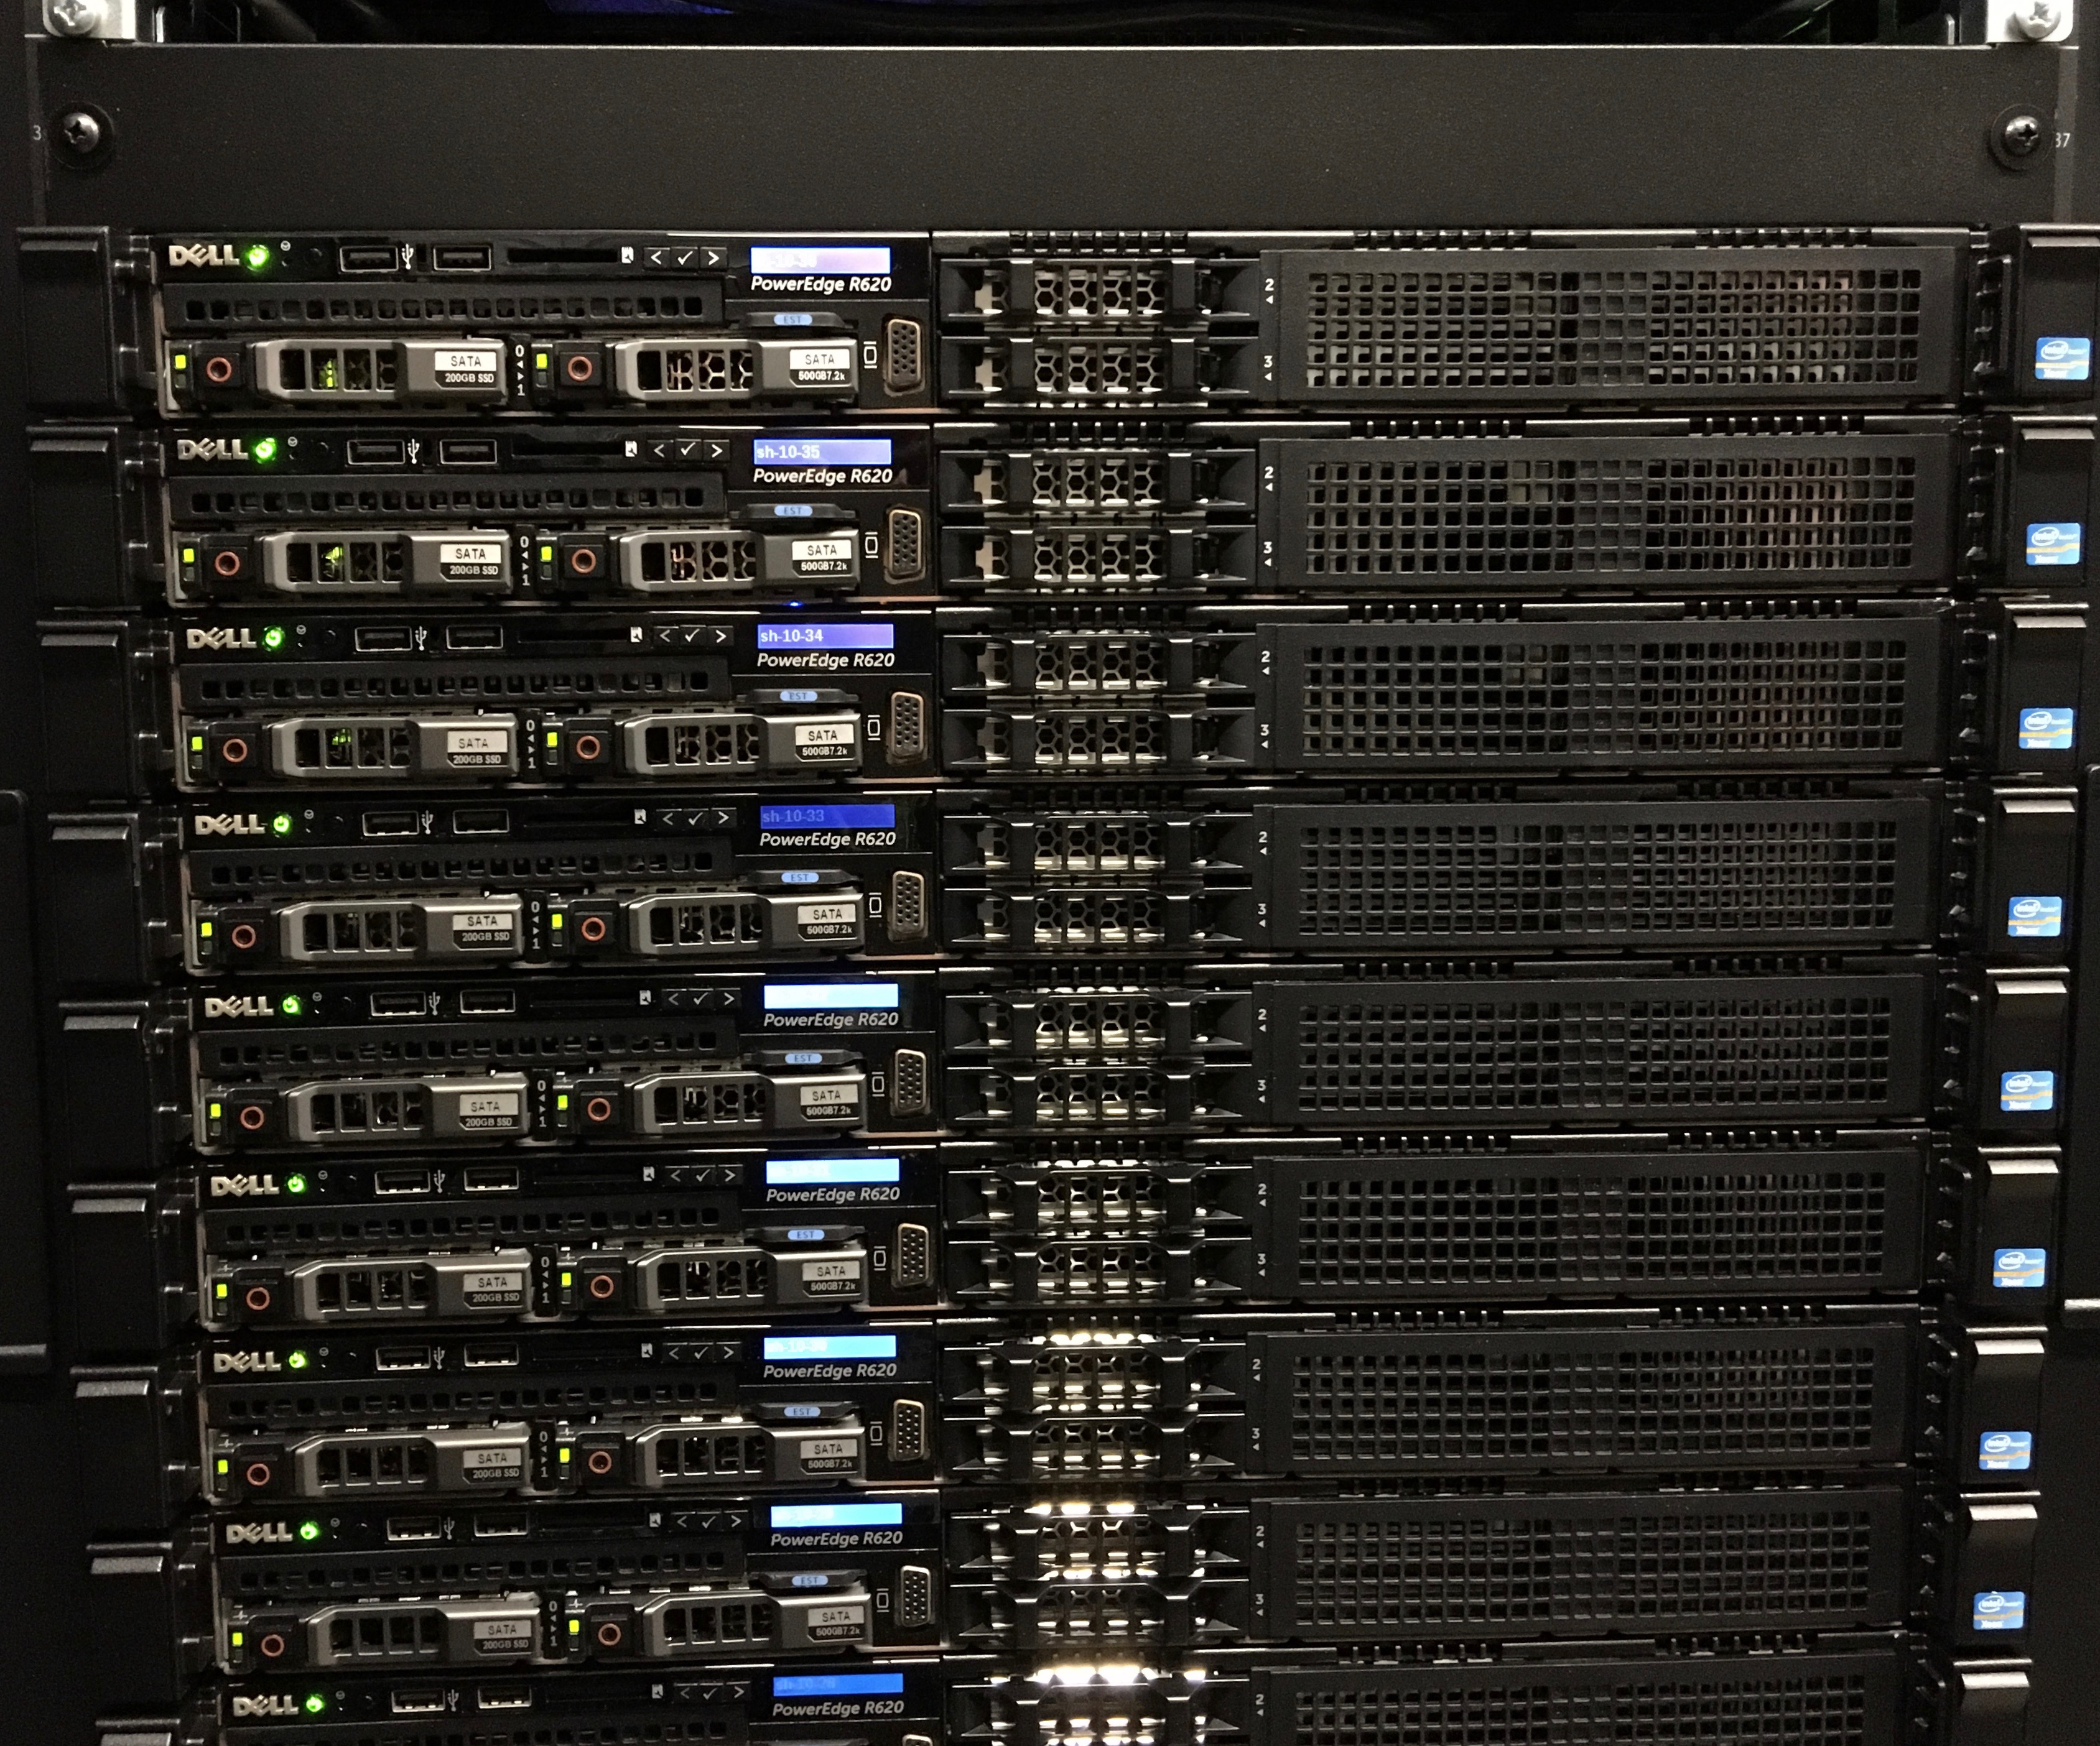
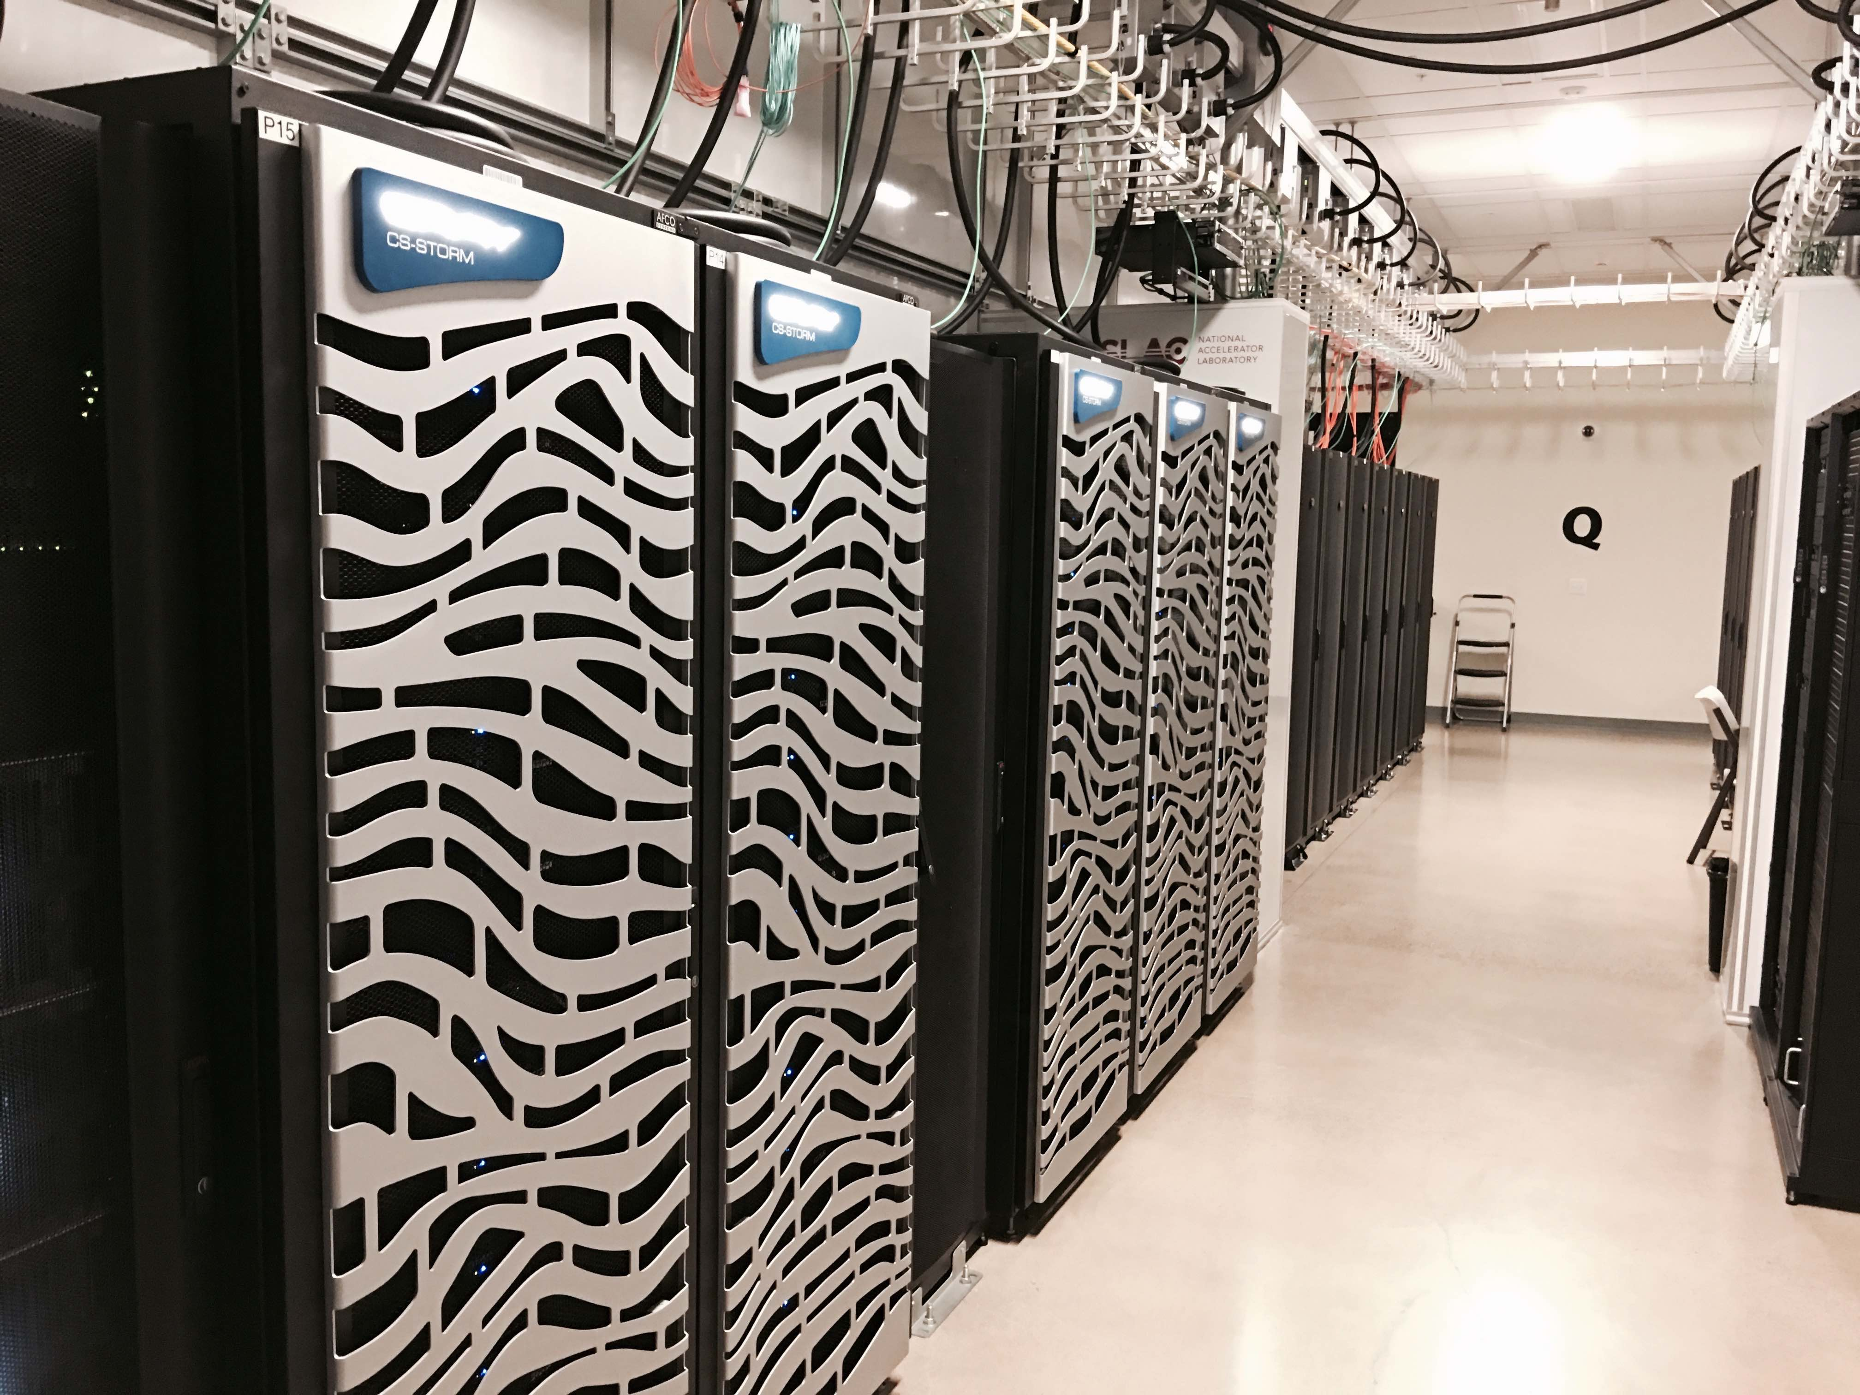
SRCF Data Center
An example day-
IT load 489 kW
Facility load 582 kW
Racks
Servers(nodes)
UPS
Generators
Networking/Fiber
Cooling
Electrical

Slide 7
What is High Performance Computing (HPC)
“HPC generally refers to the practice of aggregating computing power in a way that delivers much higher performance than one could get from a typical desktop computer or workstation in order to solve large problems.” – Inside HPC
A computer cluster is a set of connected computers working together so that, in many respects, they can be viewed as a single system. Clusters are composed of nodes set to perform the same task, controlled and scheduled by software.
A distributed system is a system whose components (nodes) are located on different networked computers (via Infiniband, Ethernet), which then communicate and coordinate their actions by passing messages to one other. The components interact with one other in order to achieve a common goal- greater computing power than individual computers.
Parallel computing is a type of computation in which many calculations or the execution of processes are carried out simultaneously. Large problems can often be divided into smaller ones, which can then be solved at the same time.

Slide 8
When will I need it?
When your computing needs are above and beyond what an average laptop or desktop can handle in terms of data storage, CPU, RAM, i/o, availability and networking.
Almost every field of research where simulations, large computation or data is needed: Astrophysics, Machine/Deep Learning, Social Sciences, Biology, Chemistry, Economics. Most common software run: R, Matlab, and Python
As far as the user is concerned it’s all about power:
[mpiercy@sh-ln04 login! ~]$ sinfo --format=%C
CPUS(A/I/O/T)
23094/1557/701/25352
(allocated/idle/other/total)
So- 25,352 CPUs on Sherlock
(ONL’s Summit has 2,282,544!)

Slide 9
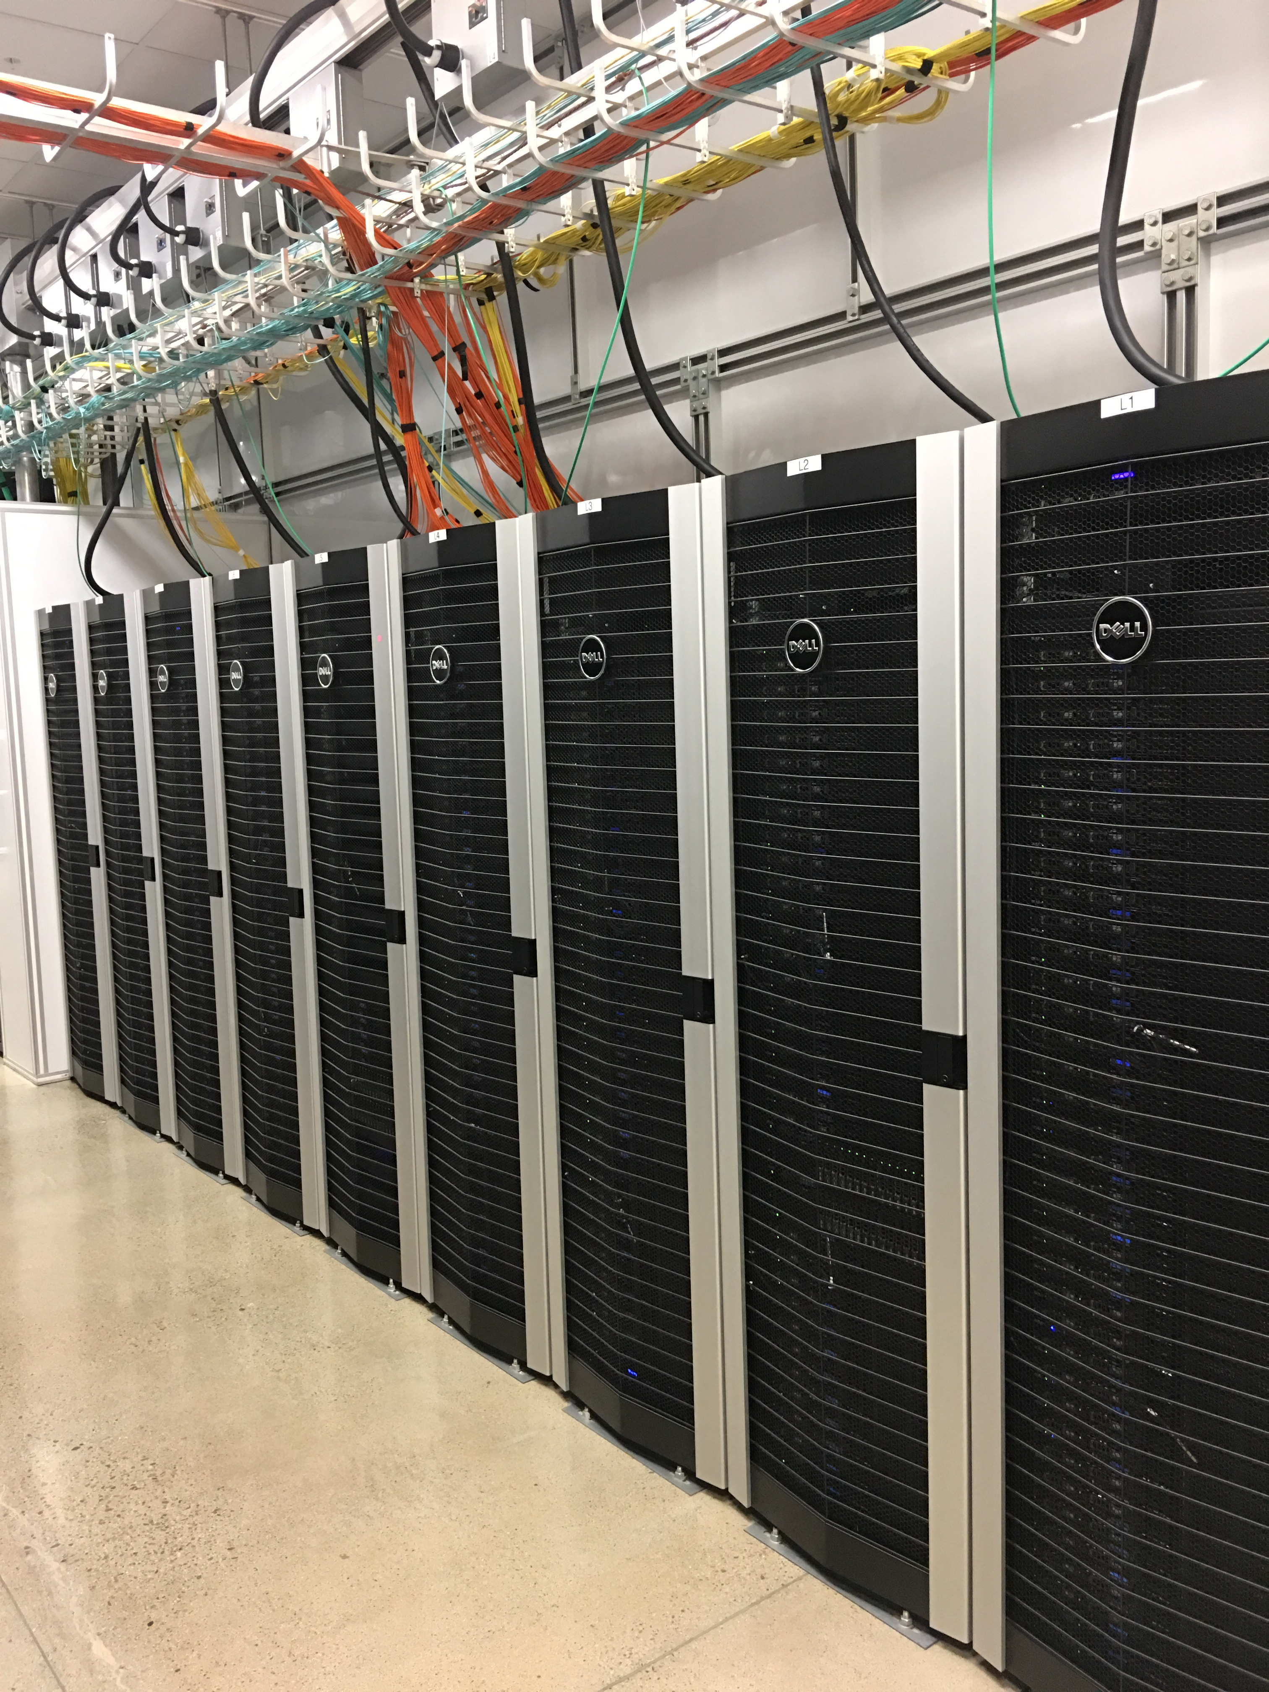
Personal Computers vs. High Performance Computers
Mac Book Pro Laptop
2 cores (1 CPU)
16 GB RAM
512GB Solid State Disk
Typical Sherlock Node
24 CPUs in two sockets Intel 2.4GHz Xeon Skylake CPU, up 256 CPUs can be run at once on Sherlock, 8,192 CPUs for owners.
192GB RAM
20TB scratch storage, 1TB group home, 100GB local Solid State Disk
Infiniband connection 100GB/s between nodes and storage (Scratch, Oak and Home)
GPU nodes (NVIDIA Kepler K80, K40, Volta V100 )
Big memory nodes (512GB, 1.5 and 3TB RAM)

Slide 10

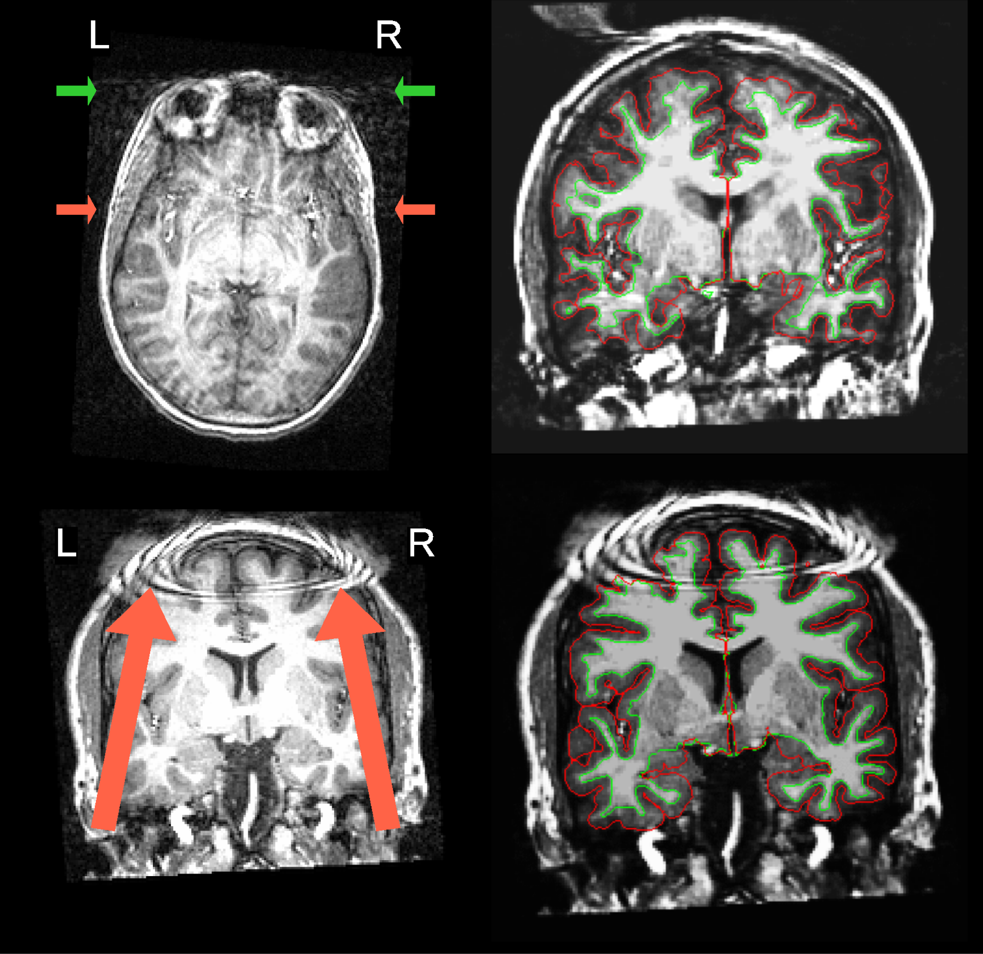
High Performance Computing Use Cases
Analyzing Gravitational Lenses 10 million times faster on Sherlock with neural networks on our GPUs, Advancing the automatic prediction of image quality in MRI from unseen sites, Stanford Open Policing project
https://srcc.stanford.edu/srcc-enabled-publications

Slide 11
Pros and Cons of HPC vs DIY/desktop
Pros-
Your code/calculations are run on servers that are always on, networked and accessible from anywhere by anyone in your PI group (including off campus collaborators with basic SUNetIDs)
High performance parallel file systems- fast i/o, 30TB of group Scratch storage on Sherlock
Much more compute power, hundreds of CPUs, large memory servers up to 3TB of RAM
Data sharing among research groups is easy, Globus for large data transfers
Data in home directories are backed up (snapshotted) and replicated
The job scheduler handles problems with hardware, hardware/nodes can fail but jobs do not, you launch your jobs and log off
Cons-
Need to learn how to use a job scheduler and the Linux command line- aka “The Shell”
Jobs go through a scheduler using the Fairshare algorithm since the system is shared by thousands of users; so you need to wait
Sometimes you need to request and wait for software installs, you will not have the same permissions to change/modify the system as you do on your own laptop, desktop or cloud instance, however often users can install software themselves on Sherlock/Farmshare

Slide 12
HPC Workflows
Research- Many users working on many problems, constantly changing environment. Jobs are heterogenous, many single CPU jobs or large multi-node jobs, large RAM, all types of jobs and software
Interactive- Users login to compute nodes and iteratively test, run their code estimate their codes resource requirements, install/load code dependencies. On Sherlock we use sdev and srun commands for this. When ready, submit the jobs as batch jobs to the pool of compute nodes with sbatch command.
Production- Fewer uses, large scale, thousands, or tens/hundreds of thousands of CPUs. The details, resource requirements, i/o, performance, have already been worked out. Static unless major changes to inputs or software, astrophysics, fluid dynamics, weather simulations, predictions. Often rely on MPI and more recently GPUs. Often jobs are running parallel across multiple nodes

Slide 13
Parallel programming paradigms
Two issues:
Efficient use of CPUs on one process
Communication between nodes to support interdependent parallel processes running on different nodes and exchanging mutually dependent data
A parallel program usually consists of a set of processes that share data with each other by communicating through shared memory over a network interconnect fabric.
Parallel programs that direct multiple CPUs to communicate with each other via shared memory typically use the OpenMP interface. The independent operations running on multiple CPUs within a node are called threads.
Parallel programs that direct CPUs on different nodes to share data must use message passing over the network. These programs use the Message Passing Interface (MPI).
Finally, programs that use carefully coded hybrid processes can be capable of both high performance and high efficiency. These hybrid programs use both OpenMP and MPI.
Two parallel programming paradigms: threads and message passing
Two ways to achieve parallelism in computing. One is to use multiple CPUs on a node to execute parts of a process. For example, you can divide a loop into four smaller loops and run them simultaneously on separate CPUs. This is called threading; each CPU processes a thread.
The other paradigm is to divide a computation into multiple processes. This causes each of the processes to depend on the same data. This interdependence requires processes to pass messages to each other over a communication medium. When processes on different nodes exchange data with each other, it is called message passing.

Slide 14
MPI
Message Passing Interface
Run code across multiple nodes, CPUs, sharing memory
Thousands of CPUs, TB of memory can be used at once
Communication protocol for programming parallel computers runs over 100GB/s Infiniband network on Sherlock nodes are connected via PCI bus
Most MPI implementations consist of a specific set of routines directly callable from C, C++, Python and Fortran
Standardized and Portable, OpenMP and MPICH OpenMP pragmas are added to code
An MPI program consists of a set of processes that share data with each other by communicating through shared memory over a network interconnect fabric.
Used in many codes for large simulations, VASP (ab initio simulations), Quantum ESPRESSO, Schrodinger, NWChem, TensorFlow
Note that you almost will never need to develop OpenMP code, more often you will be simply using it in your data analysis and research career
MPI tutorials
http://mpitutorial.com/tutorials/
https://computing.llnl.gov/tutorials/mpi/

Slide 15
Embarrassingly* Parallel Examples
Searches in cryptography. Notable real-world examples include distributed.net and proof-of work systems used in cryptocurrency.
BLAST searches in bioinformatics for multiple queries (but not for individual large queries). Sequence alignment, Mutation SNP annotation/discovery
Large scale facial recognition systems that compare thousands of arbitrary acquired faces (e.g., a security or surveillance video via closed-circuit television) with similarly large number of previously stored faces (e.g., a rogues gallery or similar watch list).
Computer simulations comparing many independent scenarios.
Tree growth step of the random forest machine learning technique.
Convolutional neural networks running on GPUs.
Hyperparameter grid search in machine learning.
For embarrassingly parallel problems true HPC with ultrafast interconnects, parallel storage etc. not always needed, but lots of CPUs are.
*meaning an embarrassment of riches- the problem is very easy to parallelize
sub-problems or tasks are defined before the computations begin
sub-solutions are stored in independent memory locations (variables, array elements)
the computation of the sub-solutions is completely independent.

Slide 16
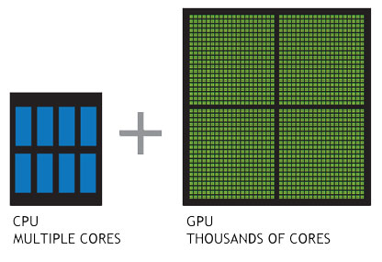
Graphics processing units: GPUs
GPUs highly parallel structure makes them
more efficient than general-purpose CPUs for
algorithms where the processing of
large blocks of data is done in parallel.
GPUs can be faster, but within a very limited set of conditions;
single precision math operations with a huge amount of arguments
per instruction
GPU are specialized for compute-intensive, highly
parallel computation and designed such
that more transistors are devoted to data processing
rather than data caching and flow control.
For task that can be parallelized
rendering graphics to a screen
running a Monte Carlo Simulation
multiplying matrices for a machine learning algorithm
However: code needs to be GPU aware
CUDA and OpenCL used to program GPUs directly
Sherlock features some of the latest generation of GPU accelerators: the NVIDIA Tesla V100.
Each V100 GPU features 7.8 TFlops of double-precision (FP64) performance, up to 125 TFlops for deep-learning applications, 16GB of HBM2
memory, and 300GB/s of interconnect bandwidth using NVLink 2.0 connections.
Each compute node features 4 V100 GPUs, and using a completely non-blocking NVLink topology

Slide 17
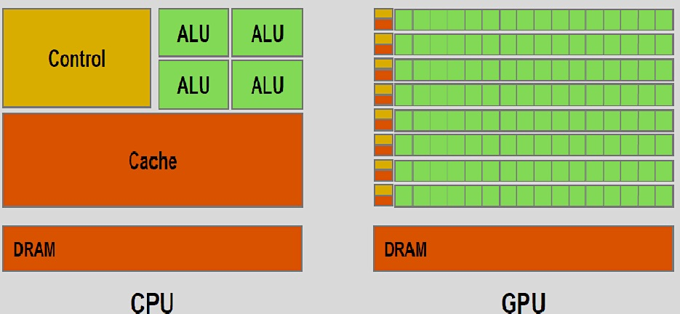
CPU vs. GPU
GPUs have many more arithmetic logical units -ALUs to calculate with.
An arithmetic logic unit (ALU) is a combinational digital electronic circuit that performs arithmetic and bitwise operations on integer binary numbers. This is in contrast to a floating-point unit (FPU), which operates on floating point numbers.

Slide 18
HPC and Cloud workflow comparisons (generalizations)
HPC- Extremely large sets of data, processing the information in parallel while sharing the data between compute nodes. The data connection between the nodes has to be very fast essentially turning the entire grid of nodes into one single “supercomputer”. This requires expensive hardware: nodes with individually high performance. One application can be run across a large number of nodes- vertical scalability.
Cloud (and HPC)- Good for embarrassingly parallel problems. An EPP problem is one in which a data set is divided into pieces which are dispatched to various computers for processing; or, several copies of a smaller data set are distributed across computers to perform different computations on it (e.g. running the application with different parameters). When done, resulting data is re-assembled. Individual computers don’t have to be super fast, the power lies in having a huge number of computers. Several applications (or, copies of the same application) run on several nodes, so horizontal scalability. Run on low cost commodity hardware. Note, these workflows commonly also run on HPC systems- just much faster.

Slide 19
Cloud (AWS, GCP, Azure) versus HPC (Sherlock, Farmshare, your on-prem cluster
Cloud
Pros
Fast access, pay as you go, small up front costs, scalable, not buying hardware
No need to learn a job scheduler
No waiting for resources not competing with hundreds of users for CPUs, RAM
You are root/sudo, install anything you want (even if it breaks everything)
Nice admin UI’s, front ends
Cons
It costs $$$, sometimes these can get very high, CPU hours and data up/downloads will cost
Sometimes does not scale well with the research/experimental paradigm
You are root, you can break things and often no one will help you fix them
Cloud-speak and concepts to learn
vendor lock-in
Instances run in VMs not bare metal
HPC
Pros
Usually free or very low cost (for users)
Fair amount of free/low cost fast parallel storage i/o is high latencies low
Maintained large research software stack
up/downloading data is free and very fast
User support (free)
Mix of GPU/CPU nodes large mem nodes, 500GB-3TB RAM
Cons
Waiting for resources
Learning a scheduler
Not root/sudo can’t install some software
Resource limits
Cluster concepts to learn

Slide 20
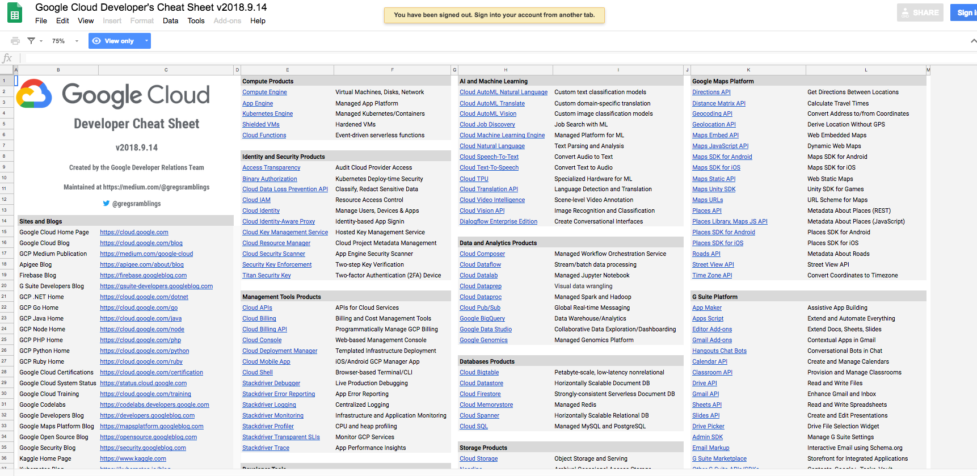
Cloud is getting pretty complex
https://medium.com/google-cloud/the-google-cloud-developer-cheat-sheet-429775bd6d11

Slide 21
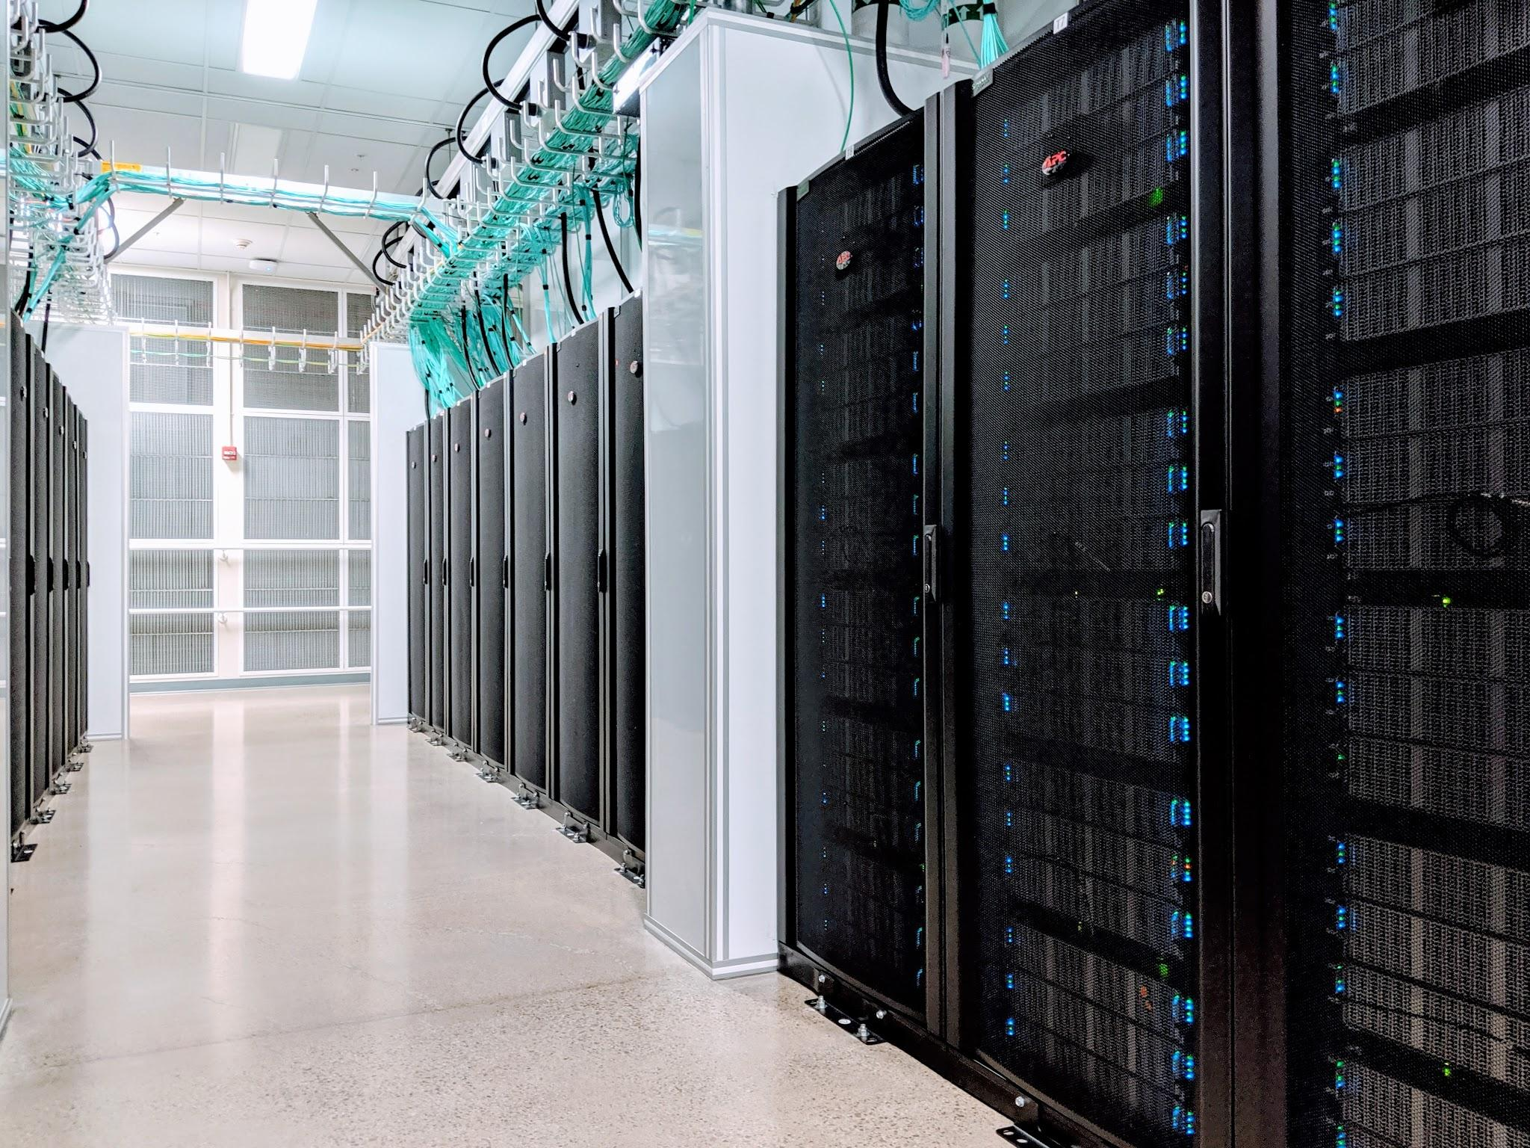

Sherlock HPC Cluster

Slide 22
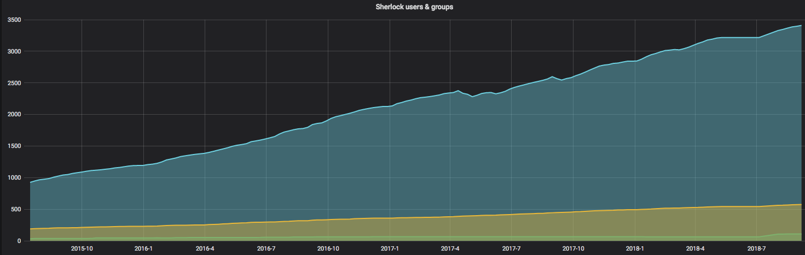
Sherlock’s user growth since 2015
4,400 users from 720 research groups, 122 partitions
6 PB scratch, 12 PB long term storage

Slide 23
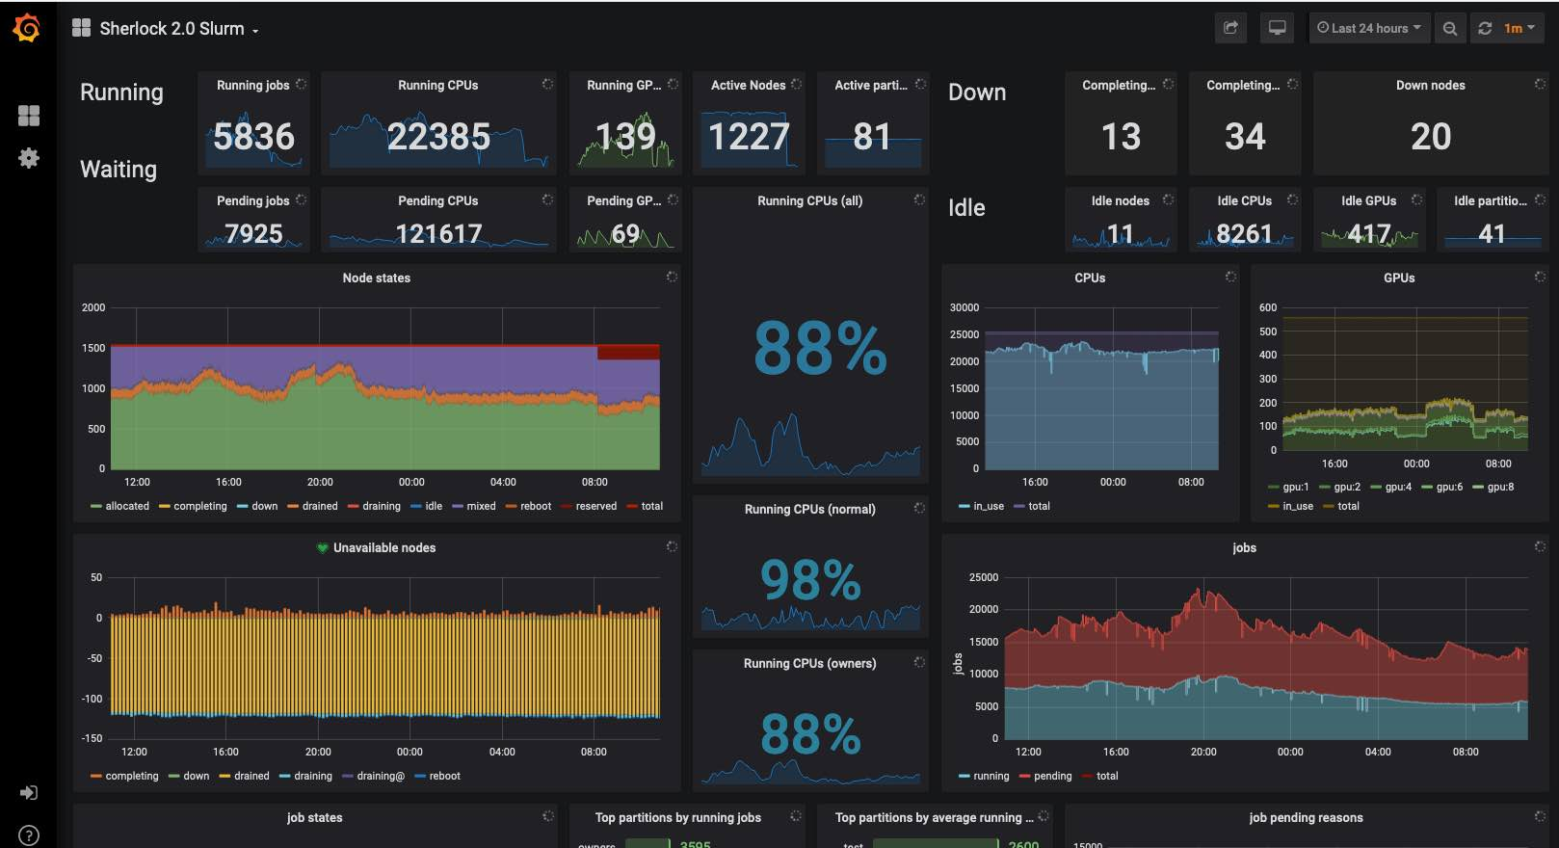
Sherlock status view

Slide 24
Sherlock System Simple Overview
Infiniband interconnect
generic nodes
sh-ln01
sh-ln02
You- connecting via ssh
sh-ln03
sh-ln04..08
specialized nodes,bigmem, data transfer (DTN)
/home
/scratch -3PB
Login nodes
Filesystems, storage servers
1,360 compute nodes

Slide 25
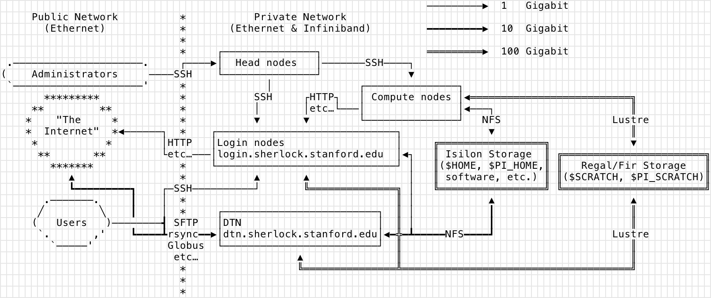
Sherlock: Connecting and Networking Internal and External

Slide 26
Common software pre-installed on Sherlock as modules
Matlab
R
Python
TensorFlow
Keras
PyTorch
423 software packages, in 10 categories, covering 58 fields of science, always growing
All stored as modules via LMOD-
$module avail
--- math -- numerical libraries, statistics, deep-learning, computer science ---
R/3.4.0 py-keras/2.1.5_py36 (g)
R/3.5.1 (D) py-numpy/1.14.3_py27 (D)
armadillo/8.200.1 py-numpy/1.14.3_py36…

Slide 27
Scheduling Jobs
Why Do We Need to Schedule a Job?
Resource contention between users needs to be balanced. So, the compute resources are managed and workloads are balanced using a job scheduler- SLURM.
How Easy Is It to Schedule a Job?
Basic concept - tell the scheduler:
What resources you need- CPUs, RAM, time, partition
What it should do- load modules, run your code
Need to request as few resources as you need so your jobs pend for as small a time as possible, profile jobs with top, htop sacct

Slide 28
Fairshare
Basically the more resources you use- CPU/RAM/Time/Nodes in a 2 week sliding window the lower your Fairshare score is, the more likely your jobs will wait in the queue.
or
A resource scheduler ranks jobs by priority for execution. Each job's priority in queue is determined by multiple factors, among them the user's fairshare score. A user's fairshare score is computed based on a target (the given portion of the resources that this user should be able to use) and the user's effective usage, i.e. the amount of resources (s)he effectively used in the past. As a result, the more resources past jobs have used, the lower the priority of the next jobs will be. Past usage is computed based on a sliding window and progressively forgotten over time. This enables all users on a shared resource to get a fair portion of it for their own use, by giving higher priority to users who have been underserved in the past.
Sherlock also uses backfill, smaller jobs can go in front of larger jobs, often regardless of the users Fairshare factor, thus increasing our clusters utilization.

Slide 29
Parallel processing
A very simple example, you have 384 files to zip-
#!/bin/sh
for FILE in *.fastq;
do
sbatch -p normal -t 10:00 --mem=200 --wrap="gzip ${FILE}"
done
Rather than being run serially on 1 or 2 CPU’s on your laptop, on a cluster there are often thousands of CPUs so all 384 files (jobs) are processed (submitted to the scheduler with the sbatch command) at once. The scheduler needs to allocate jobs->resources.
File I/O will be faster, clusters use a parallel filesystem, Lustre
Can also use SLURM Job Arrays
On Sherlock you can run on up to 256 (8,196 for owners) CPUs at once
PS-
This is an example of an embarrassingly parallel problem, little or no effort is needed to separate the problem into a number of parallel tasks. There is little or no dependency or need for communication between the parallel tasks or for the results between them.

Slide 30
Parallel Processing
On a cluster multiple tasks can be submitted via a job scheduler to many CPUs and servers at once
Pass multiple arguments to your code at once
No no need to wait for 2 or 3 cores and limited RAM on a laptop or desktop to be available
CPU
CPU
CPU
CPU
CPU
CPU
CPU
CPU
SLURM
CPU
CPU
CPU
CPU
your program
CPU
CPU
CPU
CPU
CPU
CPU
CPU
CPU
CPU
CPU
CPU
CPU
CPU
CPU
CPU
CPU
CPU
CPU
CPU
CPU

Slide 31
Parallel example with SLURM Job Arrays
Job arrays offer a mechanism for submitting and managing collections of similar jobs quickly and easily; job arrays with thousands of tasks can be submitted in milliseconds (subject to configured size limits). All jobs must have the same initial options (e.g. size, time limit, etc). Array jobs are usually limited to 1000 steps.
Here only one job is submitted to the schedular with 384 array steps. Note the files are named to match array task ID ($SLURM_ARRAY_TASK_ID)
# !/bin/sh
#SBATCH --job-name=array_zip # Job name
#SBATCH -p owners
#SBATCH --ntasks=1 # Run a single task
#SBATCH --mem-per-cpu=1gb # Memory per processor
#SBATCH --time=00:10:00 # Time limit hrs:min:sec
#SBATCH --output=array_%A-%a.out # Standard output and error log
#SBATCH --array=1-384 # Array range
#Do your work here
gzip SRR062634.$SLURM_ARRAY_TASK_ID.filt.fastq
Same thing can be done with parameter values or other arguments to your code
Note: The --ntasks parameter is only useful if you have commands that you want to run in parallel within the same batch script, i.e. your code is multithreaded or MPI enabled

Slide 32
srun SLURM tasks- an example of resource control
#!/bin/bash
#SBATCH --ntasks=1
#SBATCH --time=1:00
#SBATCH –mem=8GB
## more options
echo hello from $SLURM_JOB_NODELIST
Output:
hello from sh-30-02
In SLURM terminology, a task is an instance of a running program.
If your program supports communication across computers (MPI) or you plan on running independent tasks in parallel, request multiple tasks with –ntasks= , the default value is set to 1.
Programs require a certain amount of memory to function properly. To see how much memory your program needs, you can check the documentation or run it in an interactive session and use the htop command to profile it. To specify the memory for your job, use the mem-per-cpu option. Clusters have defaults to make job submission easier for users.

Slide 33
srun SLURM tasks example cont.
change last line to:
srun echo hello from $SLURM_JOB_NODELIST
Output:
hello from sh-27-[17,20]
hello from sh-27-[17,20]
hello from sh-27-[17,20]
hello from sh-27-[17,20]
hello from sh-27-[17,20]
hello from sh-27-[17,20]
hello from sh-27-[17,20]
hello from sh-27-[17,20]
A task in SLURM analogous to a process in Unix, i.e. a running instance of a program with it’s own memory and CPU allocation.
Task allocations are controlled by the user via SLURM.
You can see in the last example that the command was not only run 8 times ( 8 tasks) but run across the cluster on 2 different nodes. Used for multithreaded applications and MPI. SLURM allows a lot of resource granularity. For example if you want one process that can use 16 cores for multithreading use srun with:
--ntasks=1
--cpus-per-task=16

Slide 34
Sample Batch Job
#!/bin/bash
#SBATCH --job-name=test
#SBATCH --time=10:00
#SBATCH –p normal
#SBATCH --cpus-per-task=1
#SBATCH –mem=16GB
#below you run/call your code, load modules, python, Matlab, R, etc.
# and do any other scripting you want
#lines that begin with #SBATCH are directives to the scheduler-SLURM
module load python/3.6.1
module load py-keras/2.2.4_py36
python my_code.py
______________________________________________________________
Edit with vim/nano/vi and save as test.sbatch
To run:
$sbatch test.sbatch
To watch:
$ squeue –u $USER
Many ways to control jobs as they run, scontrol pause/update, scancel

Slide 35
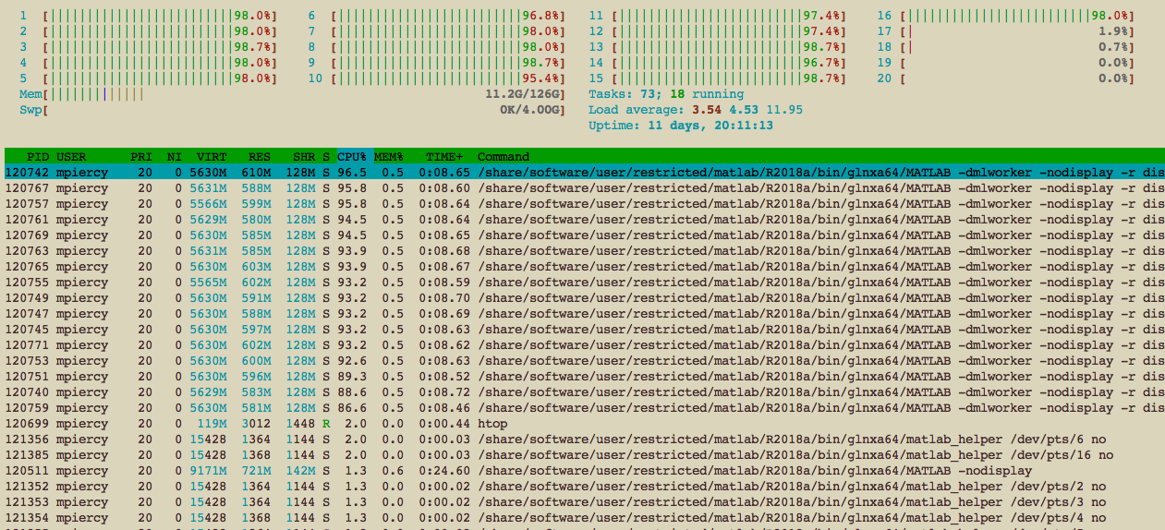
Matlab multicore example with Matlab’s parfor
#!/bin/bash
#SBATCH -N 2
#SBATCH -c 32
#SBATCH -t 0-15:00
#SBATCH -p hns
module load matlab
echo $SLURM_CPUS_PER_TASK
srun -c $SLURM_CPUS_PER_TASK matlab -nosplash -nodesktop -r "pfor"

Slide 36
Sherlock Partitions
Partition- a logical and physical set of nodes in a cluster
QOS long (--qos=long, the only QOS needed) jobs >2 days <7 days
What partitions can I run on?
scontrol show partition | egrep -B1 "AllowGroups=.*$(id -gn $user).*" | awk -F= '/PartitionName/ {print $2}’
What’s nodes are on the partition?
sinfo –N –p normal --long
Partition | Number of Nodes
normal | 84
owners | 1,176
hns | 85
bigmem (500GB-3TB RAM) | 2
gpu | 8
dev | 2
Your PI’s own nodes (donoho), stat | 4, 3

Slide 37
Sherlock Filesystems
Home and Group Home, backed up, snapshotted and replicated offsite
$HOME 15 GB
$GROUP_HOME 1 TB
Scratch- fast Lustre parallel filesystem, your jobs should write/read here (6 month purge policy, unless you have purchased $OAK space- $50 per TB/year)
$SCRATCH 20 TB
$GROUP_SCRATCH 30 TB
$LOCAL_SCRATCH 200GB
Local to your jobs node, even faster, but gets deleted at the end of your job
http://www.sherlock.stanford.edu/docs/user-guide/storage/filesystems/
rclone, gdrive connections to cloud storage

Slide 38
Sherlock User Limits
View the various partition limits with the sacctmgr command-
sacctmgr show qos format=Name,MaxTRESPerUser,MaxSubmitJobsPerUser,MaxJobsPerUser,MaxWall
Name MaxTRESPU MaxSubmitPU MaxJobsPU MaxWall
---------- ------------- ----------- --------- -----------
normal cpu=256 1000 2-00:00:00
dev cpu=4,mem=16G 2 02:00:00
long cpu=32 20 16 7-00:00:00
bigmem mem=3T 10 1-00:00:00
gpu gres/gpu=8 50 2-00:00:00
owner cpu=99999 3000 7-00:00:00
owners cpu=8192 3000 2-00:00:00
donoho cpu=40,gres/+ 3000 7-00:00:00

Slide 39
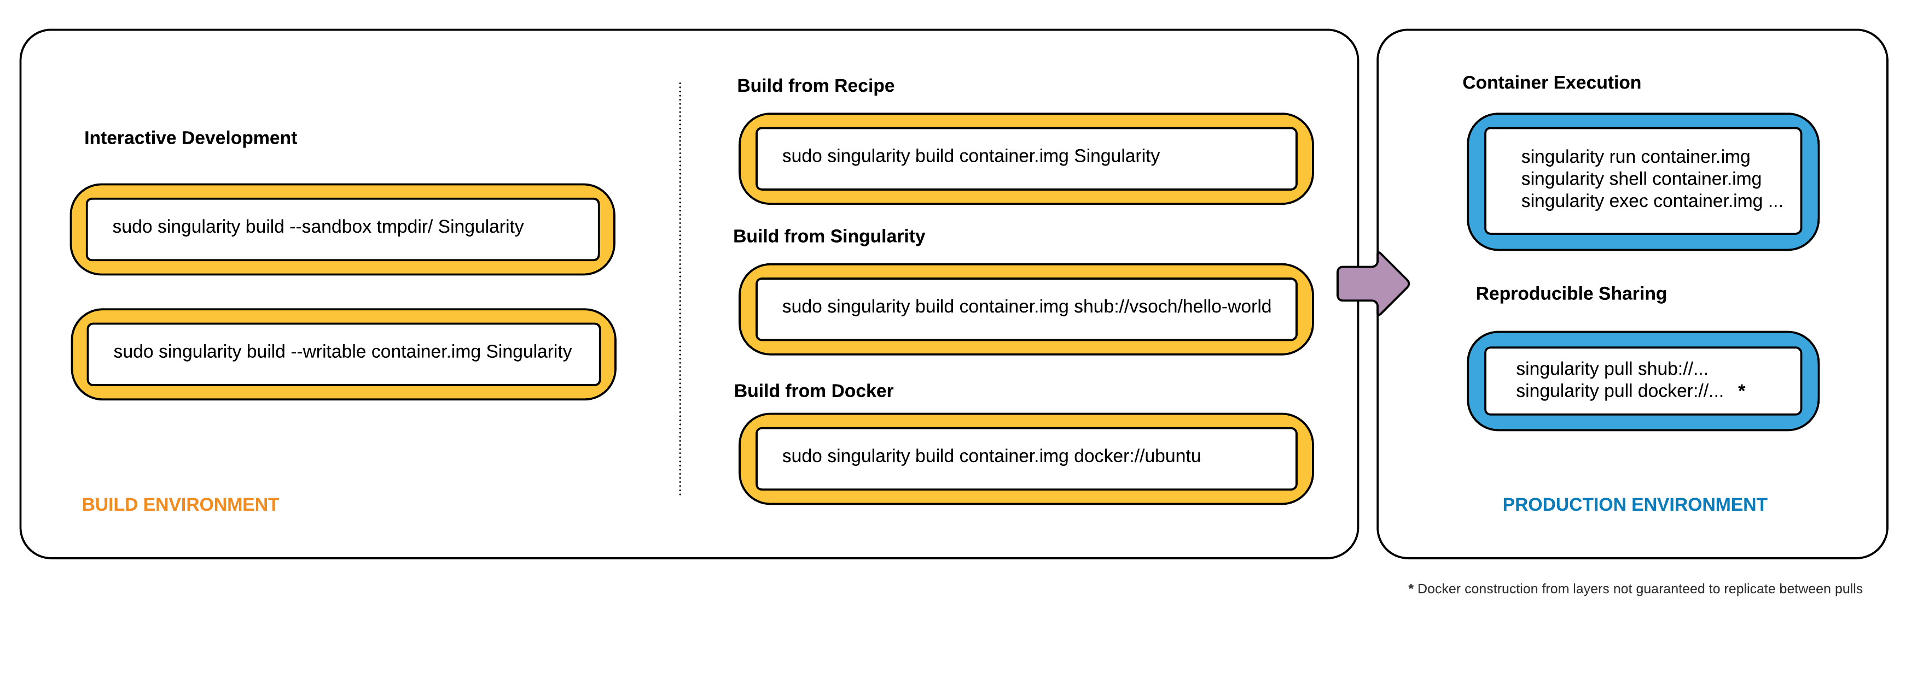
Singularity Containers
Singularity containers are great if you have code/data with many dependencies that you cannot install on a cluster
Build the container as root on your local system then move onto cluster and run
https://www.sylabs.io/docs/

Slide 40
Sherlock vs. Farmshare
http://www.sherlock.stanford.edu
Available for use by all Stanford faculty and their research teams
Work done must be directly related to the faculty member's research.
A set of servers are free and open to all at Stanford doing sponsored research. Faculty can supplement shared nodes by purchasing additional servers, and become an owner
The owning group will have exclusive use of purchased nodes and access to the over 1,100 owner compute nodes when idle.
http://farmshare.stanford.edu
Primarily intended for use in coursework and unsponsored research
Anyone with a Stanford ID (SUNet ID) can log in
Shared servers
Helps those doing research have a place to test codes and learn about technical solutions to assist in reaching their research goals, prior to scaling up to Sherlock
1,325 compute nodes
24,000 CPU cores
1,195 GPUs
1,590 TFlops
3,400 users
547 research groups
109 Owners
20 128 GB RAM compute nodes.
4 767 GB RAM compute nodes.
10 128 GB RAM nodes with an Nvidia Tesla K40.
Shared storage for your group or class.
Sherlock is approved for Medium Risk. Neither system is approved for use with high-risk data, PHI, or PII.
Notes:
Update the specs of Sherlock vs Farmshare. Use the same terminology/comparisons

Slide 41
The HPC Condo Model
Sherlock PIs can buy 1 or more nodes (starting at about $7,500)
The PI’s group members will have exclusive use of these nodes
Access to idle resources in the owners partition of 1,120 nodes
An owner’s group members will be able to use up to 8,192 CPUs at once in the owners partition
However, jobs in the owners queue are preemptible, if the owner of the node you’re running on wants to use those resources, your job is finished. So these jobs need to be checkpointed in some way. Or at the very least you need to be able to logically aggregate the data at that state and restart processing.
Currently there are 125 owners on Sherlock with a total of 1,158 nodes
Sherlock node orders -https://srcc.stanford.edu/private/sherlock-orders

Slide 42

Future Directions- GIUs and ease of use for HPC
Tools have been developed in order to make accessing HPC resources much easier.
Ohio Super Computing Center has developed Open on Demand.
Users can access an HPC cluster’s shell, launch jobs, Jupyter notebooks, RStudio, edit files all within their web browser.
http://openondemand.org/
Access Sherlock via browser
https://login.sherlock.Stanford.edu

Slide 43
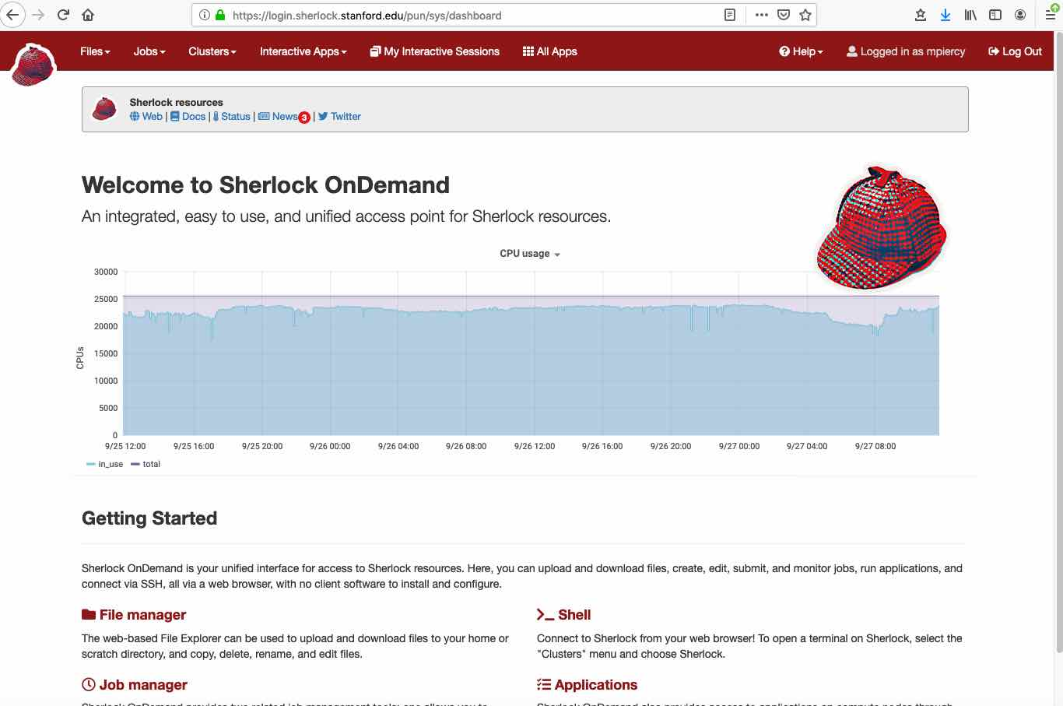
Web browser access to Sherlock

Slide 44
How Can I Obtain Access to HPC?
Sherlock
Your PI or Faculty Sponsor simply needs to request an account - http://www.sherlock.stanford.edu/
Farmshare
Everyone with a full service SUNet ID can access:
Log into rice.stanford.edu using a SSH client
If you have a Mac/PC, open the Terminal application and type: ssh [sunet]@rice.stanford.edu
https://web.stanford.edu/group/farmshare/cgi-bin/wiki/index.php/Main_Page
https://srcc.stanford.edu/farmshare2
Stanford Genomics Cluster-SCG4
Very large bioinformatics stack some free use nodes. A charged service of the Genetics Bioinformatics Service Center
https://web.stanford.edu/group/scgpm/cgi-bin/informatics/wiki/index.php/Scg4_user_guide
UV300 Supercomputer
10 TB of RAM over 360 cores, 4 P100 GPUs
http://med.stanford.edu/gbsc/uv300.html
Notes:
THIS SHOULD BE ALTERED DEPENDING ON WHICH GROUP YOU’RE PRESENTING TO

Slide 45


HPC resources for projects with large compute needs
XSEDE - Extreme Science and Engineering Discovery Environment a powerful, and robust collection of HPC resources and services, a single virtual system that scientists can use to interactively share computing resources, data, and expertise.
https://www.xsede.org/
Open Science Grid-
Facilitates access to HPC clusters. The resources are contributed by the community, organized by the OSG. In the last 12 months, OSG has provided more than 1.2 Billion CPU hours to researchers
https://www.opensciencegrid.org/

Slide 46
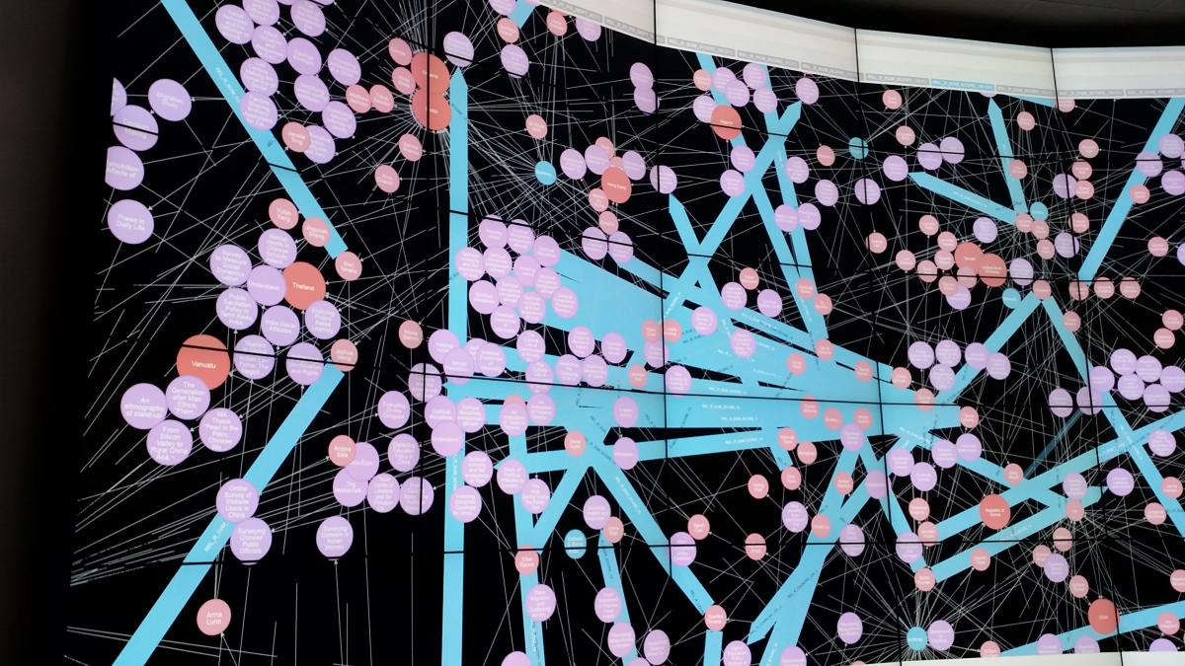
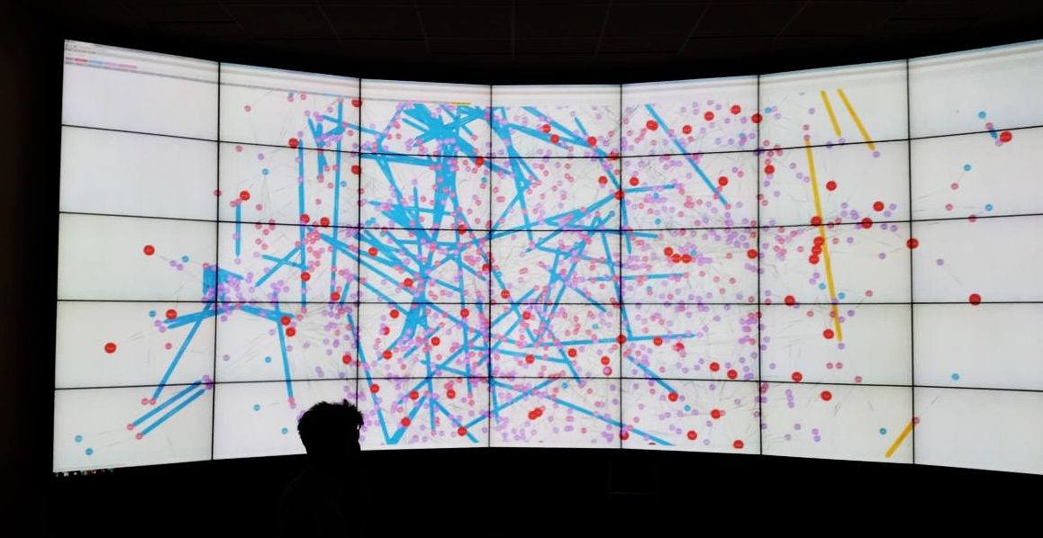
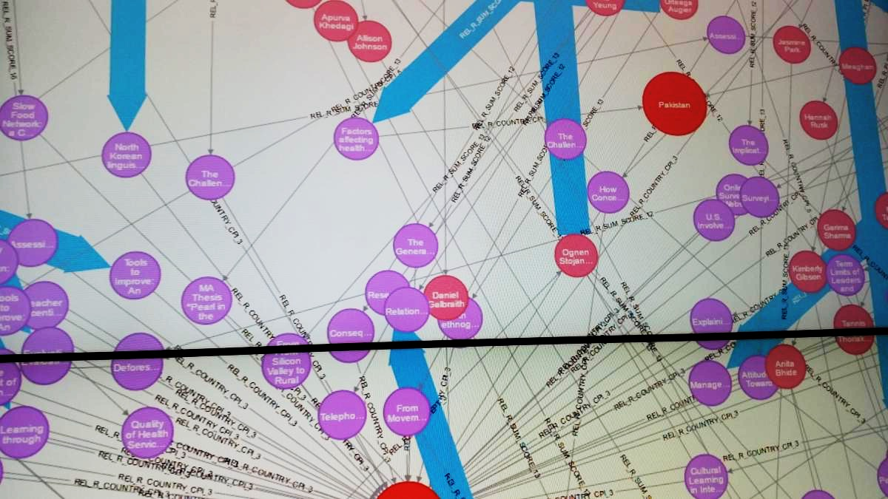
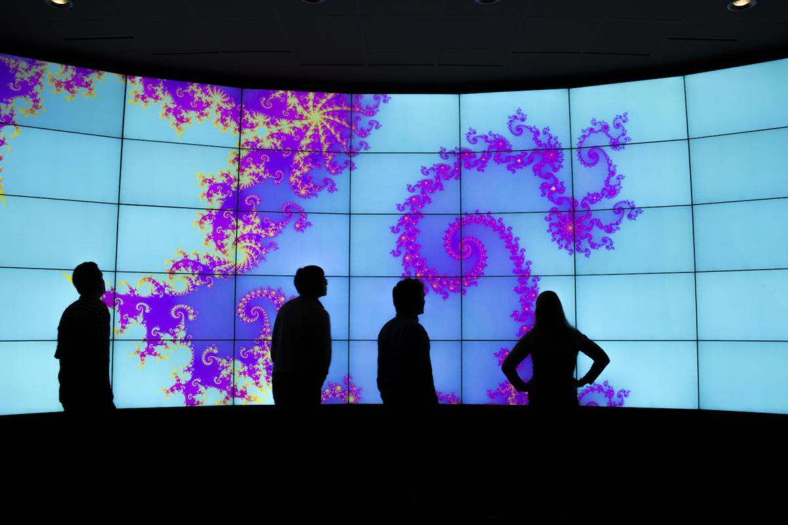
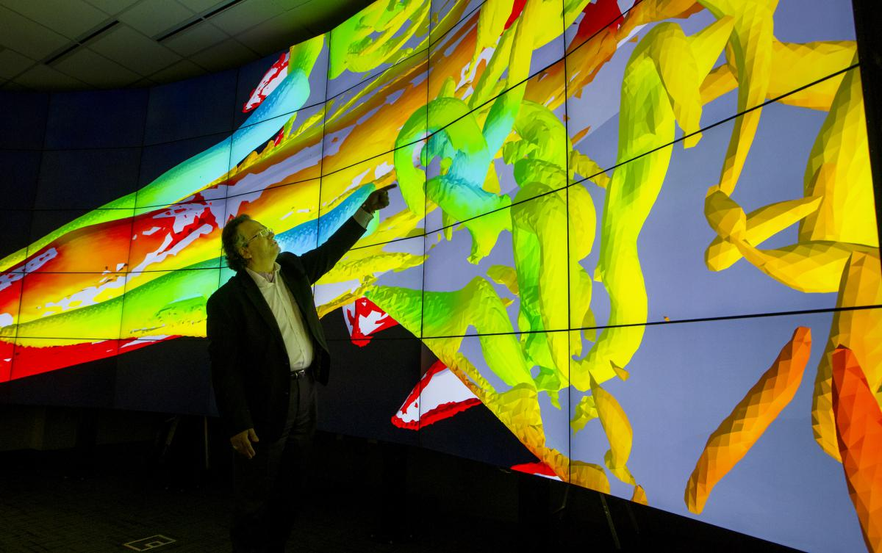
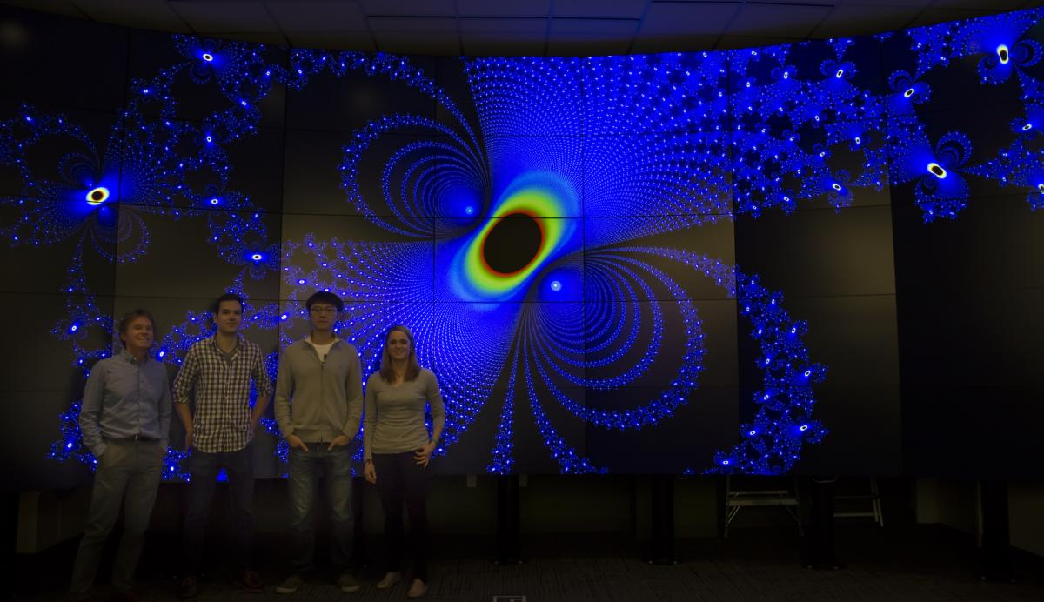
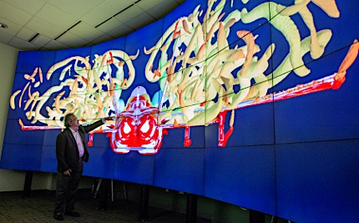
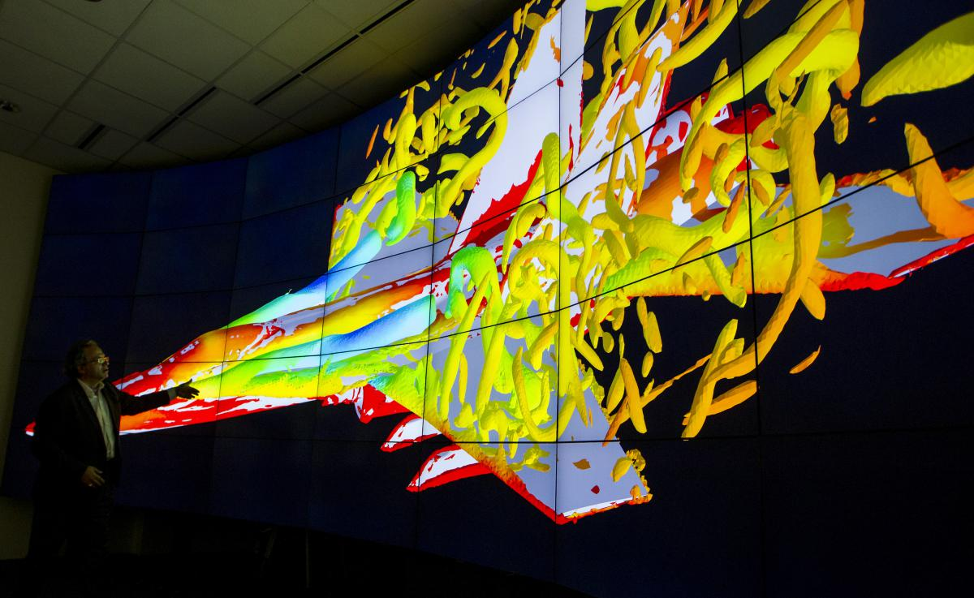
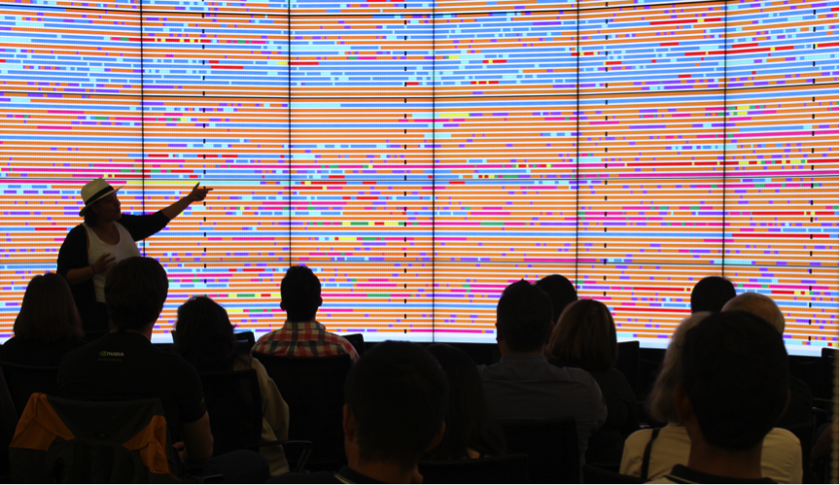
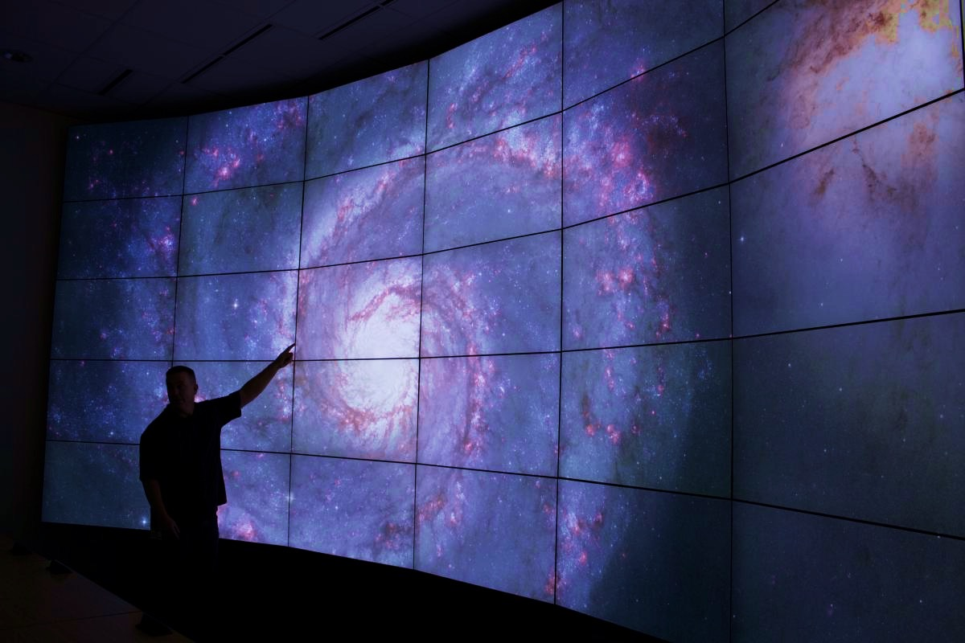
Want to Display Your Work 10x24’ ? Welcome to HIVE
10-foot-tall by 24-feet-wide display with 13440x5400 resolution
and 72 million total active pixels. Located in Huang B050
Use multiple displays simultaneously to investigate various aspects of data collection,
simulation, and visualization and to zoom in to see detail at previously unheard-of-levels. Free to use for teaching, research by any groups at Stanford.
https://icme.stanford.edu/resources/hive

Slide 47
To Learn More
Documentation
Sherlock: http://www.sherlock.stanford.edu/
Farmshare: http://farmshare.stanford.edu
Contact
Questions/Answers: srcc-support@stanford.edu
SRCC group: http://srcc.stanford.edu
Mark Piercy: mpiercy@stanford.edu
Notes:
THIS SHOULD BE ALTERED DEPENDING ON WHICH GROUP YOU’RE PRESENTING TO

Slide 48
Links
https://hpc-carpentry.github.io/hpc-intro/
https://www.sherlock.stanford.edu/docs/overview/glossary/
https://slurm.schedmd.com/
https://support.ceci-hpc.be/doc/_contents/QuickStart/SubmittingJobs/SlurmTutorial.html
GPUs
https://nyu-cds.github.io/python-gpu/01-introduction/
https://insidehpc.com/2017/03/introduction-gpus-hpc/
https://computing.llnl.gov/tutorials/dataheroes/GPUParallelProgramming.pdf
https://www.youtube.com/watch?v=49DzPT9HFJM
https://storage.googleapis.com/pub-tools-public-publication-data/pdf/43438.pdf
https://medium.com/the-mission/why-building-your-own-deep-learning-computer-is-10x-cheaper-than-aws-b1c91b55ce8c
https://www.top500.org
https://insidehpc.com/
Distributed TensorFlow
https://deepsense.ai/tensorflow-on-slurm-clusters/
SRCC Acknowledged Publications
https://srcc.stanford.edu/srcc-enabled-publications

